Slide 1
Paper 1- Developmental Biology (semester -IV) Topic-Gametogenesis
Dr. J.N.Papadkar
(Assistant professor)
Dept. of Zoology
M.G. College , Armori

Slide 2
Spermatogenesis
Spermatogenesis
The Testis
Sertoli cell
Germinal cell

Slide 3
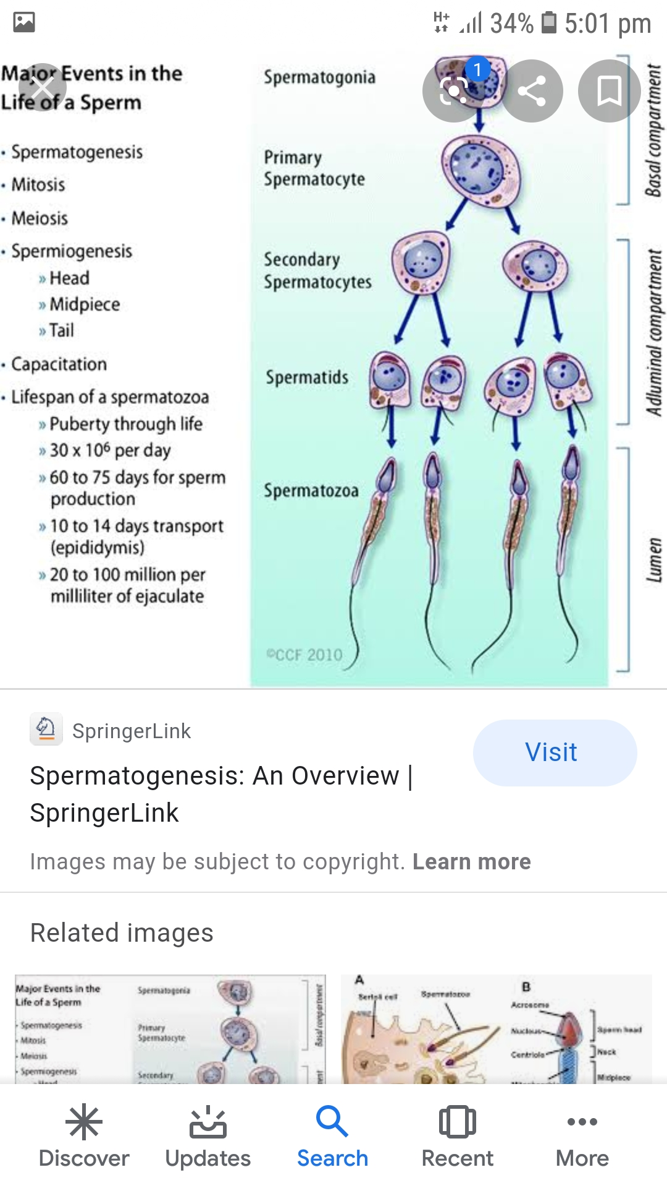
The process of Spermatogenesis
Formation of spermatid
Multiplication phase
Growth phase
Maturation phase

Slide 4
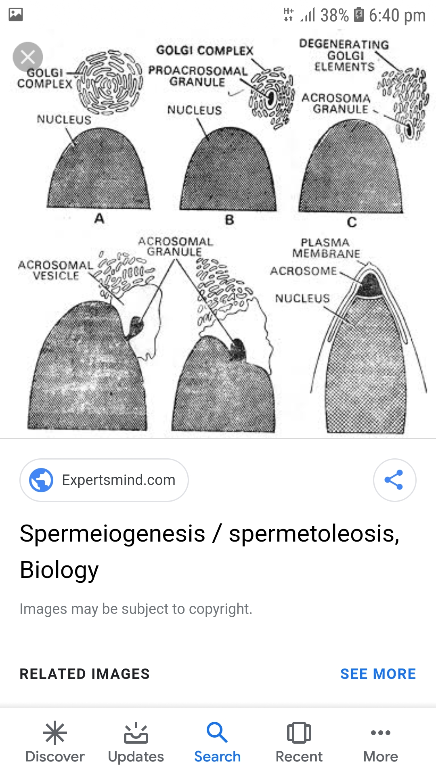
First meiotic or maturation division Second meiotic or maturation division
Spermiogenesis
Changes in nucleus
Acrosome formation
Changes in centrosome
Changes in mitochondria
Changes in cytoplasm
Ring centriole
Axial filament

Slide 5
Structure of mature spermatozoa
Head
Middle piece
Tail or flagellum

Slide 6
Oogenesis The ovary {structure of mammalian ovary}

Slide 7
The process of Oogensis
Multiplication phase
Growth phase
Pre- vitellogenesis
Growth of nuclear substances
Growth of cytoplasmic substances
Vitellogenesis
Role of follicle and nurse cells
Follicle cells
Nurse cells
Maturation phase

Slide 9
Presented by– Dr.Jayesh Papadkar.
Prepared on-3 April 2020.
Thank you!

